Slide 1

NANDHA ENGINEERING COLLEGE
DEPARTMENT OF COMPUTER SCIENCE AND ENGINEERING
REVIEW 1
VIVA VOICE
27/04/2026
Temporal Facial Dynamics–Driven Audio-Visual Emotion Recognition Using Vision Transformers
GUIDE: TEAM MEMBERS:
Mrs. E. Padma AP/CSE Chanthuru S R (22CS013)
Hariprasad M (22CS030)
Mohana Prasath G (22CS050)

Slide 2
ABSTRACT
Emotion recognition is a key component of affective computing, enabling intelligent interaction in healthcare, education, and human-computer interaction. Many existing facial emotion recognition methods rely on static representations from a single frame, failing to capture how expressions evolve over time. This work proposes a Temporal Facial Dynamic-Driven Audio-Visual Emotion Recognition framework that uniformly samples multiple facial frames from video sequences, encodes each frame using a Vision Transformer (DINOv2), aggregates frame-level embeddings via temporal average pooling, fuses visual features with Wav2Vec 2.0 speech embeddings and uses a transformer-based fusion network for emotion classification.

Slide 3
EXISTING SYSTEM
Current Approach
Most existing audio-visual emotion recognition systems process facial data as static patterns — extracting features from a single video frame — completely ignoring the temporal evolution of facial expressions.
Static Frame Analysis
Temporal Dynamics Ignored
Only one frame per video is used, failing to capture micro-expressions and gradual emotional transitions over time.
Emotions evolve through subtle muscle movements; static methods miss the dynamic nature of affective states.
Misclassification Risk
Incomplete Multimodal Fusion
Similar static appearances of emotions like 'neutral' and 'sad' lead to high confusion rates in single-frame systems.
Audio-visual systems without temporal facial modeling underperform; missing expression dynamics reduces overall accuracy.

Slide 4
PROPOSED SYSTEM
It captures facial expression changes over time instead of relying on a single static image. Multiple frames are extracted from video to represent emotion progression. Each frame is processed using a Vision Transformer to obtain visual features. These features are combined to form a temporal representation of facial emotions and audio signals are processed using a self-supervised speech model. The system extracts important speech features like tone, pitch, and emotion cues. Audio and visual features are fused together for better understanding. A transformer-based fusion model learns relationships between both modalities. The final output is accurate emotion classification. This approach improves performance by using both temporal facial data and audio signals.

Slide 5
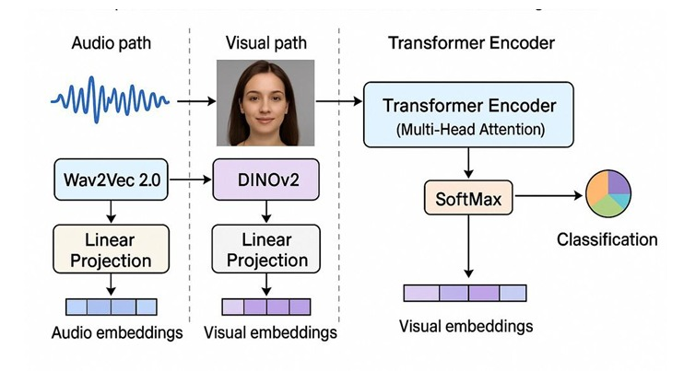
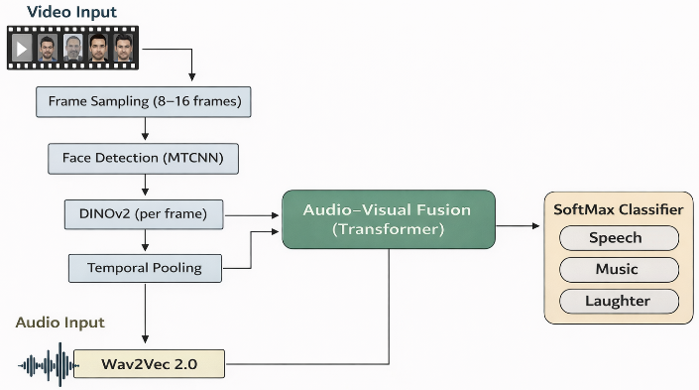
ARCHITECTURE OF PROPOSED MODEL
Architecture of Proposed wavDINO-Emotion Model
Overview of the proposed temporal facial dynamics–driven audio-visual emotion recognition framework.

Slide 6
LIST & DESCRIPTION MODULE
Data Preprocessing
Temporal Aggregation
Audio resampled to 16kHz and normalized. Facial region localized using MTCNN and resized to 224x224 px to meet Vision Transformer input requirements.
This module combines the frame-level visual features into a single representation. Temporal average pooling is applied to capture the progression of facial expressions, helping the model understand emotion dynamics instead of static images.
Temporal Frame Sampling
Audio Feature Extraction
8-16 frames uniformly sampled per video. Ensures sufficient temporal coverage of facial expression dynamics across the full video duration.
Wav2Vec 2.0 encodes raw speech waveforms into fixed-length embeddings capturing emotional acoustic properties: tone, pitch, and prosody.
Visual Feature Extraction
Multimodal Fusion
This module extracts facial features from video by sampling frames, detecting faces using MTCNN, and generating visual embeddings through a Vision Transformer.
This module merges audio and visual features using a transformer model to improve emotion recognition by learning relationships between speech and facial expressions.

Slide 7

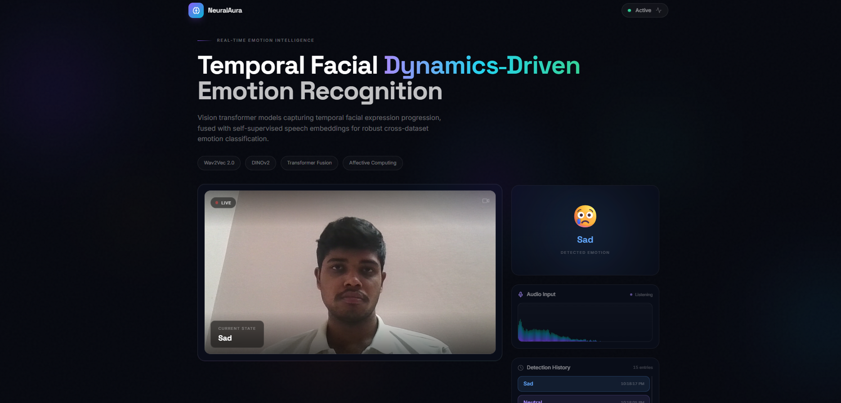
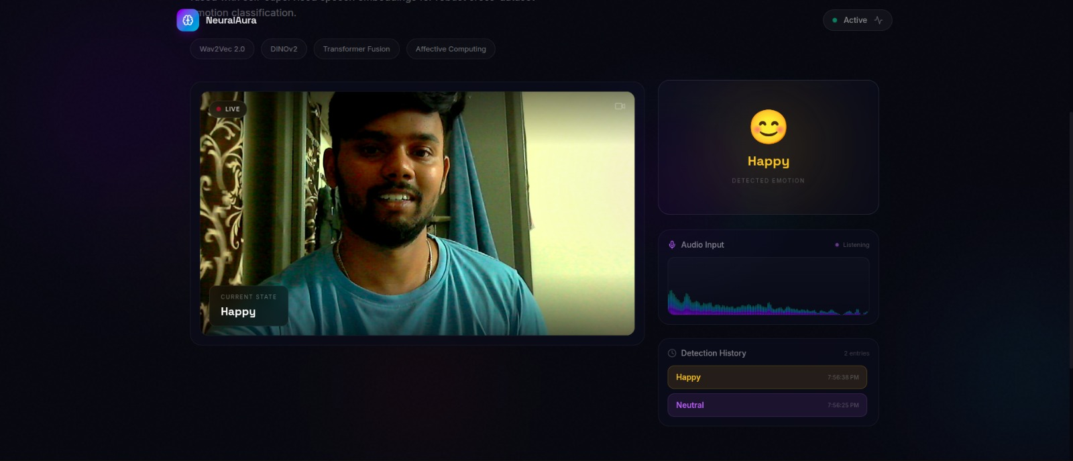
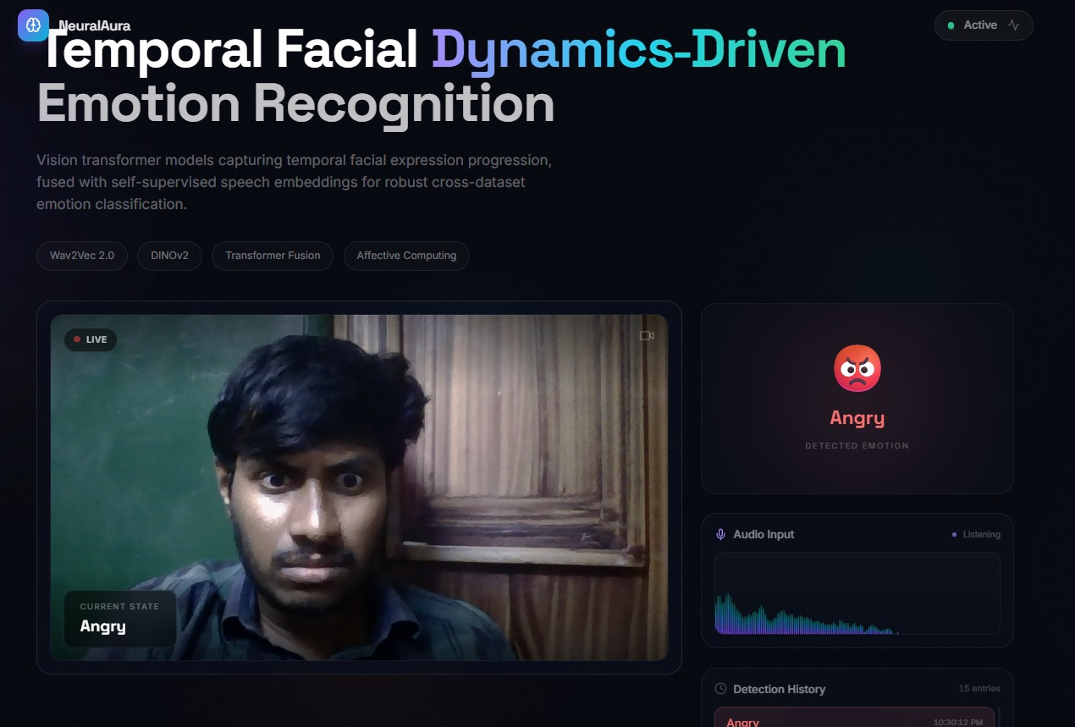
SCREENSHOTS

Slide 8
DEMO — RESULTS & EVALUATION
Dataset-wise Performance
Model Comparison
Dataset Accuracy F1-Score
Audio-Only
84.5%
0.83
CREMA-D 87.8% 0.87
Visual – Static
83.2%
0.82
RAVDESS 86.7% 0.86
Audio-Visual – Static
86.0%
0.85
AFEW 73.1% 0.70
Audio-Visual – Temporal (Proposed)
87.3%
0.86
Cross-Dataset Evaluation
Train: CREMA-D => Test: RAVDESS
Train: CREMA-D => Test: AFEW
Train: RAVDESS => Test: CREMA-D
Accuracy: 85.0% F1-Score: 0.84
Accuracy: 71.4% F1-Score: 0.69
Accuracy: 83.8% F1-Score: 0.83

Slide 9
CODING
The complete source code for the wavDINO-Emotion framework and the Temporal Facial Dynamics-driven Audio-Visual Emotion Recognition framework, including all pre-processing pipelines, model architectures, training scripts and evaluation utilities, is available in the following GitHub repositories:
wavDINO-Emotion Framework:
https://github.com/hariprasad2005/wavDINO-Emotion
Temporal Facial Dynamics Framework:
https://github.com/hariprasad2005/temporal-audiovisual-emotion

Slide 10
REAL-WORLD APPLICATIONS
Mental Health Monitoring:
AI detects emotional distress during telemedicine consultations.
Customer Service Analytics:
Emotion detection during support calls.
Smart Education Systems:
AI detects student confusion or engagement during online classes.
Driver Monitoring Systems:
Detect driver fatigue or stress in vehicles.

Slide 11
CONCLUSION
Temporal modelling captures the evolution of facial expressions over time, enabling a better understanding of emotional dynamics. Multimodal fusion further enhances emotion recognition accuracy by combining both audio and visual features. The proposed model achieves 87.8% accuracy on the CREMA-D dataset and outperforms traditional static audio-visual models, demonstrating improved robustness, better distinction of similar emotions, and strong generalization across different datasets.

Slide 12
FUTURE SCOPES
Lightweight Attention
Develop lightweight temporal attention mechanisms for faster inference without sacrificing accuracy.
Real-Time Deployment
Engineer real-time emotion recognition pipelines suitable for live production environments.
Noise Robustness
Improve model robustness to acoustic and visual noise in challenging real-world conditions.
Telehealth & Education
Deploy in telehealth platforms and smart classrooms for adaptive, emotion-aware interactions.
Edge Optimization
Optimize models for edge-device deployment (mobile, IoT) with model compression techniques.

Slide 13
REFERENCES
[1] B. Nasersharif and M. Namvarpour, "Exploring the potential of Wav2Vec 2.0 for speech emotion recognition using classifier combination and attention-based feature fusion," The Journal of Supercomputing, vol. 80, no. 16, pp. 23667–23688, 2024.
[2] C. Sun, Y. Zhou, X. Huang, J. Yang, and X. Hou, "Combining Wav2Vec 2.0 fine-tuning and ConLearnNet for speech emotion recognition," Electronics, vol. 13, no. 6, p. 1103, 2024.
[3] B. T. Atmaja and A. Sasou, "Evaluating self-supervised speech representations for speech emotion recognition," IEEE Access, vol. 10, pp. 124396–124407, 2022.
[4] S. Park, M. Mark, B. Park, and H. Hong, "Using speaker-specific emotion representations in Wav2Vec 2.0-based modules for speech emotion recognition," IEEE Access, 2023.
[5] T. Chettaoui, N. Damer, and F. Boutros, "Are foundation models ready for face recognition?" Image and Vision Computing, vol. 156, p. 105453, 2025.
[6] T. Nguyen et al., “Hybrid CNN–RNN architecture for real-time emotion detection,” in Proc. IEEE Real-Time Systems
Conference, 2022.
MPCON 2026 | Paper ID: 1571241337 | Temporal Facial Dynamics – Driven AV Emotion Recognition

Slide 14
10 / 0
Thank You
Affective Computing • Self-Suevisd Learning • Multimodal AI

